Slide 1

CYCLISTIC CASE STUDY
January-December 2023
By: Ryan Neil A. Salas

Slide 2
Scenario:
Tools:
This analysis is based on the Google Data Analytics Certificate case study. I am assuming the position of a ‘Jr. Data Analyst’s role at Cyclistic, a bike-share company based in Chicago. The analysis aims to understand the behaviours between Cyclistic’s two main users: members and casual users
I will be using Microsoft Excel to clean and analyse the Data. I will be following Google’s six-step process of processing data: ask, prepare, clean and process, analyse, share, and act.
Notes:
n 2016, Cyclistic launched a successful bike-share offering. Since then, the program has grown to a fleet of 5,824 bicycles that are geotracked and locked into a network of 692 stations across Chicago. The bikes can be unlocked from one station and returned to any other station in the system anytime.

Slide 3
Ask:
In this phase, we must put importance on what are the major questions that will help and drive our analysis further. Given that the companies’ membership has been stagnant for quite a while there are clear indications that the casual riders are doing something differently. So, the question is “How do annual members and casual riders use Cyclistic bikes differently?”

Slide 4
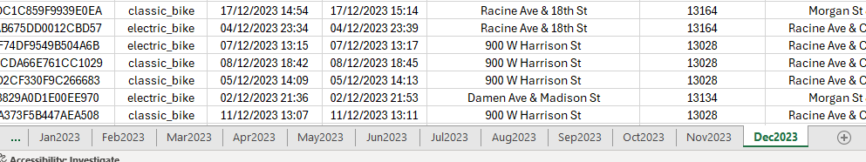
Prepare:
First, the data for this analysis can be collected here. Each table was in CSV format, I used the data from January-December 2023. I download them one by one and put each month on different sheets in Excel.
Once I had all the needed data in each Sheet, I made sure to create duplicates of the CSV file and the Excel File in case I made a mistake or accidentally destroyed the data. Then I checked if there were any null values and any duplicates in each sheet.

Slide 5
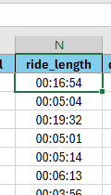
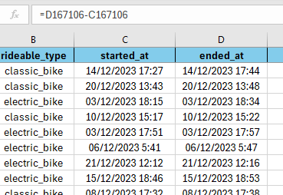
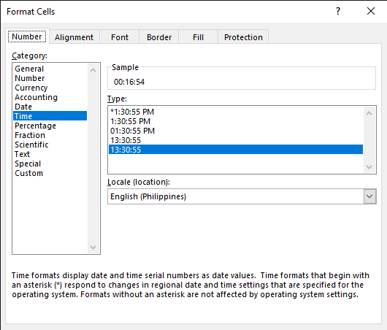
Clean and Process:
Once I understood what rows have NULL values, I deleted them and the duplicates. After there are no NULL values and duplicate values.
I added new rows for analysis purposes. The first thing I added was the Ride Length As ride_length,
by subtracting ending time from starting time and formatting it into time.

Slide 6
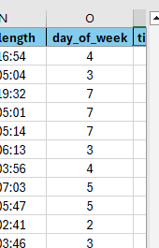
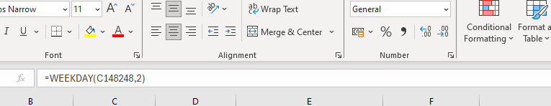
Clean and Process:
The second thing I added was the Day of the week AS the day_of_week to understand what day the User rented the bike.
Using the formula =WEEKDAY([cell],2) where 2 is the type of code format which indicates that 1 = Monday and 7 = Sunday

Slide 7
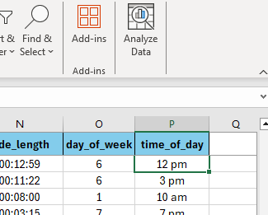
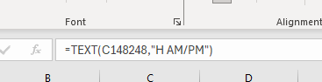
Clean and Process:
The next thing I added was the time of day AS the time_of_day to understand what general time the user rented the bike.
Using the formula =TEXT([cell],” H AM/PM”) we convert raw numerical data into text strings. Taking only the hour from the data.

Slide 8
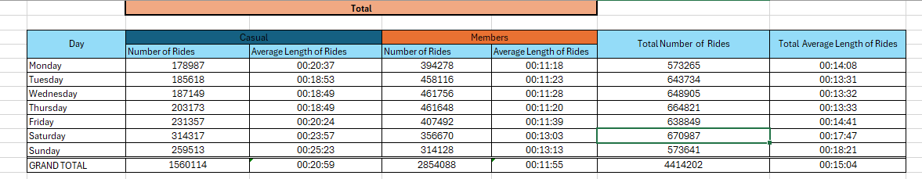
Analyse:
Once the data has been cleaned and processed, I can now analyse the data. Going back to the main question “How do annual members and casual riders use Cyclistic bikes differently?”
we can now make a connection and compare the casual users and members on how much time they use the bike, what time of day, and what day of the week they usually rent them. Based on the table there are differences in how they use the bikes. On the member’s side, there are more rides on the weekdays than on the weekends while on the casual user’s side, there are more rides on weekends and casual users have more average rides.

Slide 9
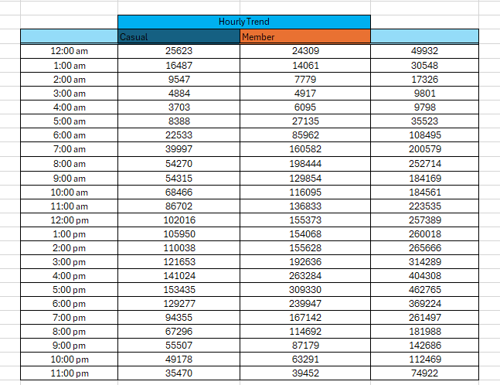
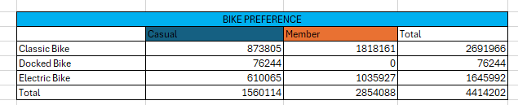
Analyse:
Next, we find what time of day has more rides, we can see there are more renters in the afternoon. On the member’s side, there is a huge influx at 7 am and 5 pm which means they use the bike for their daily commute to work.
Then, we will check what bike they prefer, which is the classic bike.

Slide 10
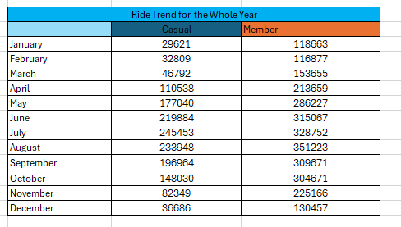
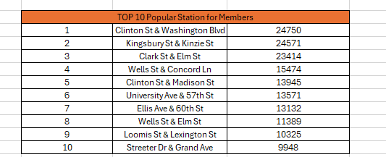
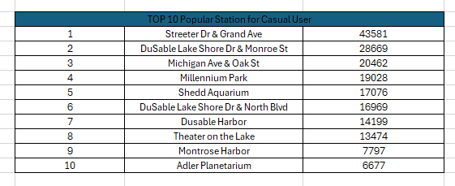
Analyse:
After that, we need to find the riding trend for the whole year to see what month is the most popular which is July, and August which is the end of summer to autumn.
We also need to check the top places that are popular with the members and casual users. For the Casual members, the most popular places are mostly aquariums and Parks which means they use the bikes for recreational purposes.

Slide 11
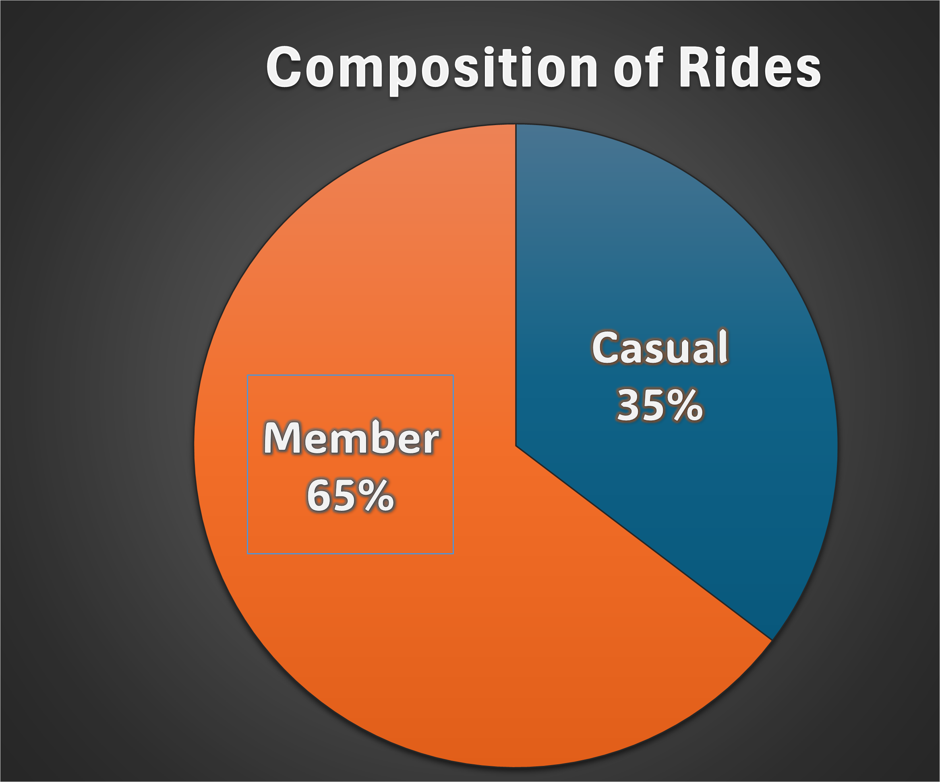
Share:
In this phase, I will share my insight using graphs to make it easier to understand the analysis. First, we will check how many rides are members and casual users to see how many percent we need to push depending on their goal.

Slide 12
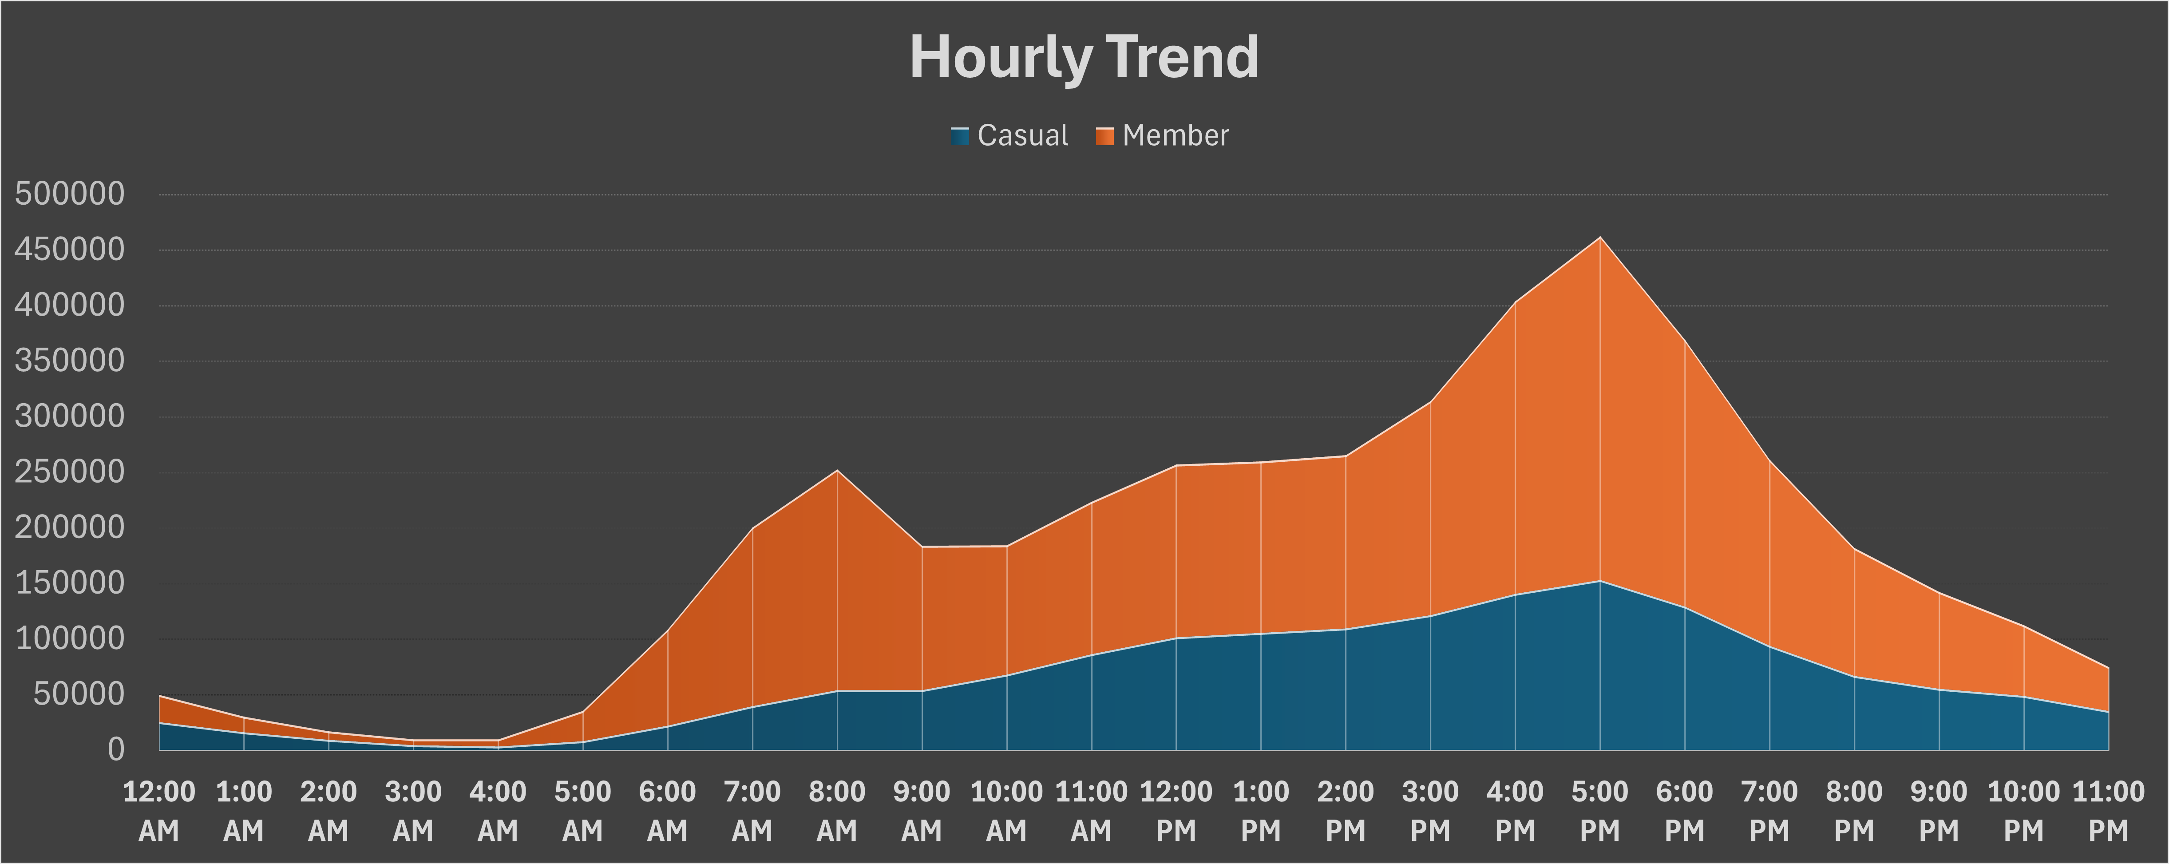
Share:
Next, we need to visualize the hourly trend.
On the member side, there are two spikes which are at 8 am and 5 pm which means the members use the bikes for their daily commute to work or class. On the casual user’s side, they mostly ride in the afternoon. In the next slide, we will gain more insights into how casual users use the bike.

Slide 13
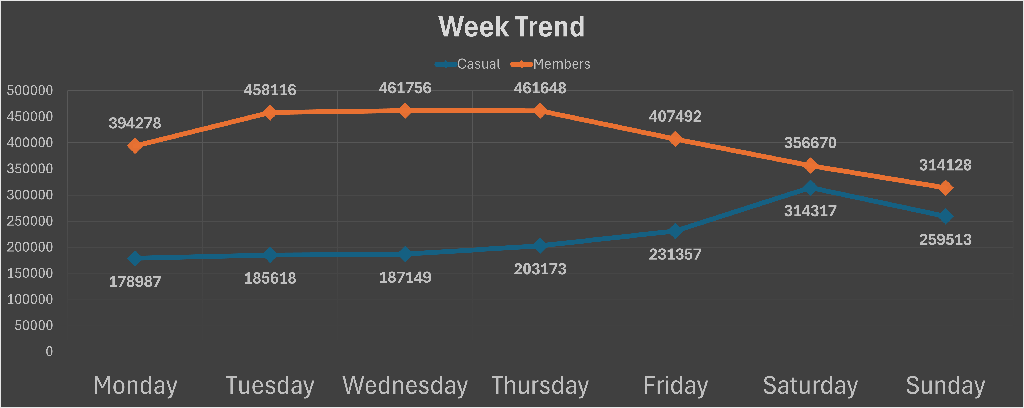
Share:
Based on the graph it adds to the evidence that members use the bike for work or class and on the casual user side they mostly use it on the weekend for recreational purposes.

Slide 14
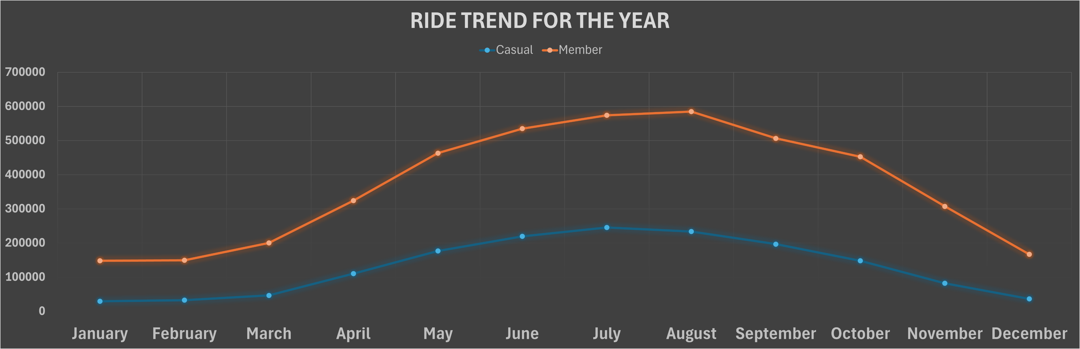
Share:
Next, we need to visualize the yearly trend.
The number of riders starts to rise in the summer and peaks in autumn. We can use this information by making an event or discounts on months that have high users.

Slide 15
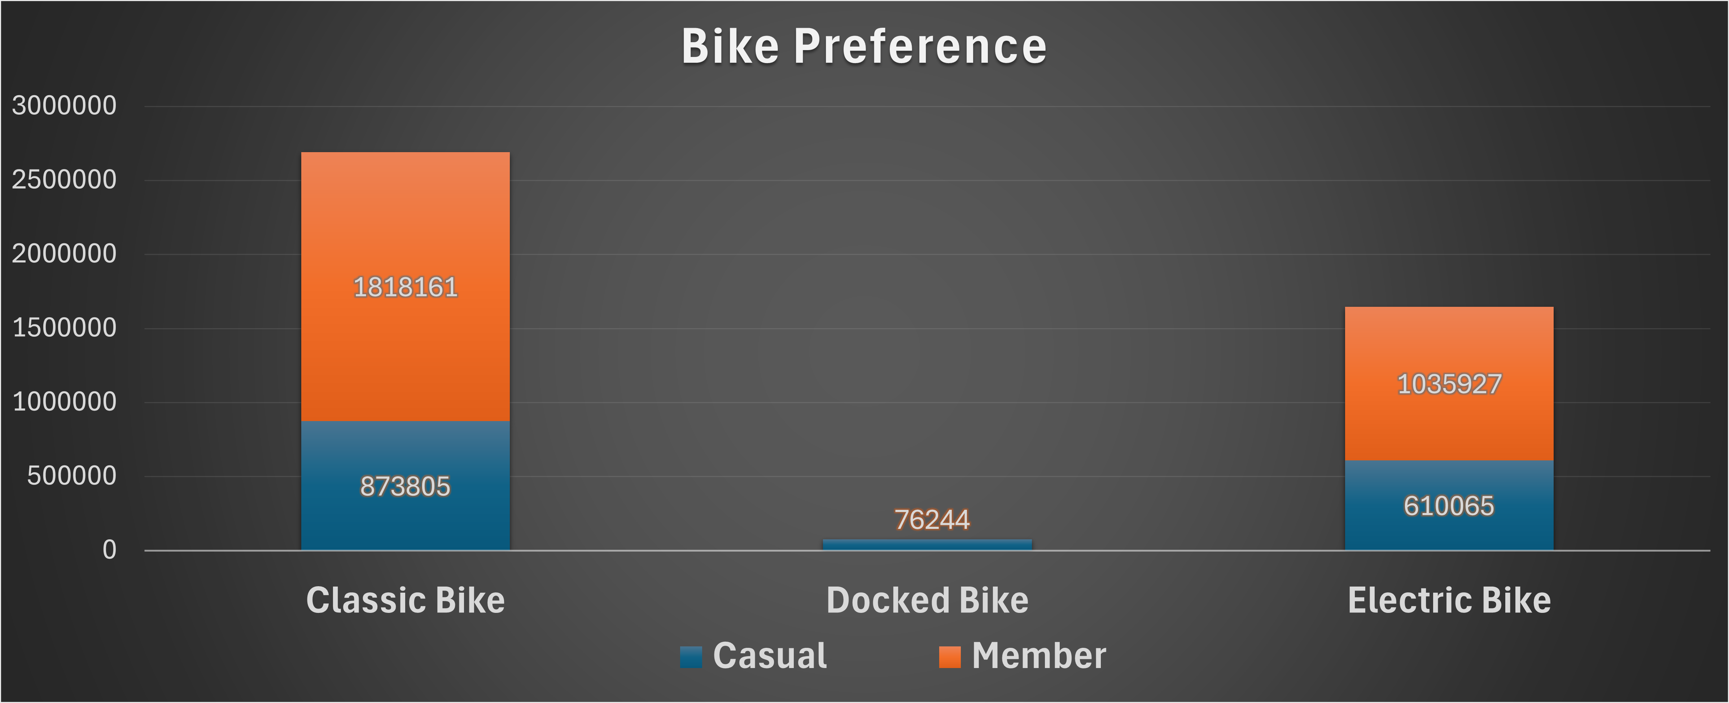
Share:
As the graph shows both the member and the casual user prefer the classic bike over the electric bike

Slide 16
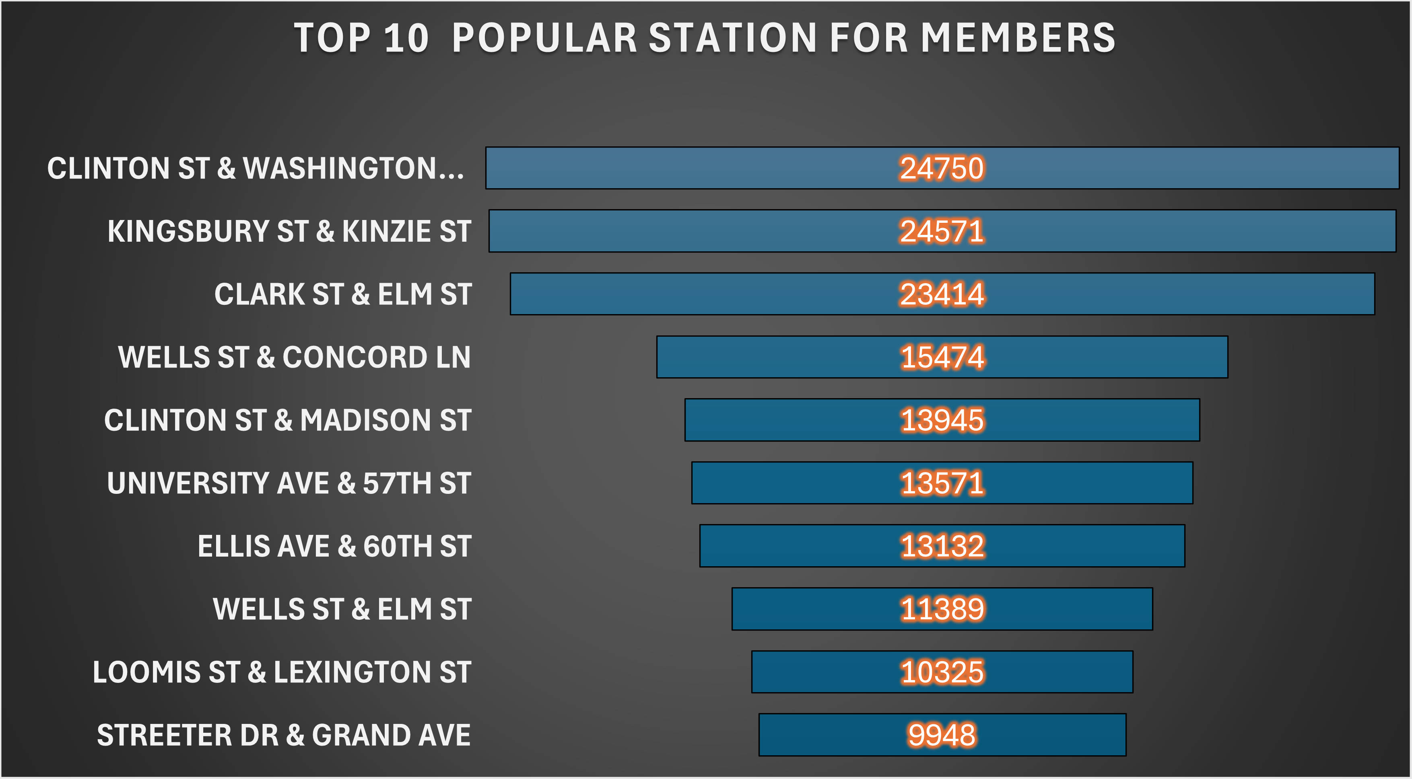
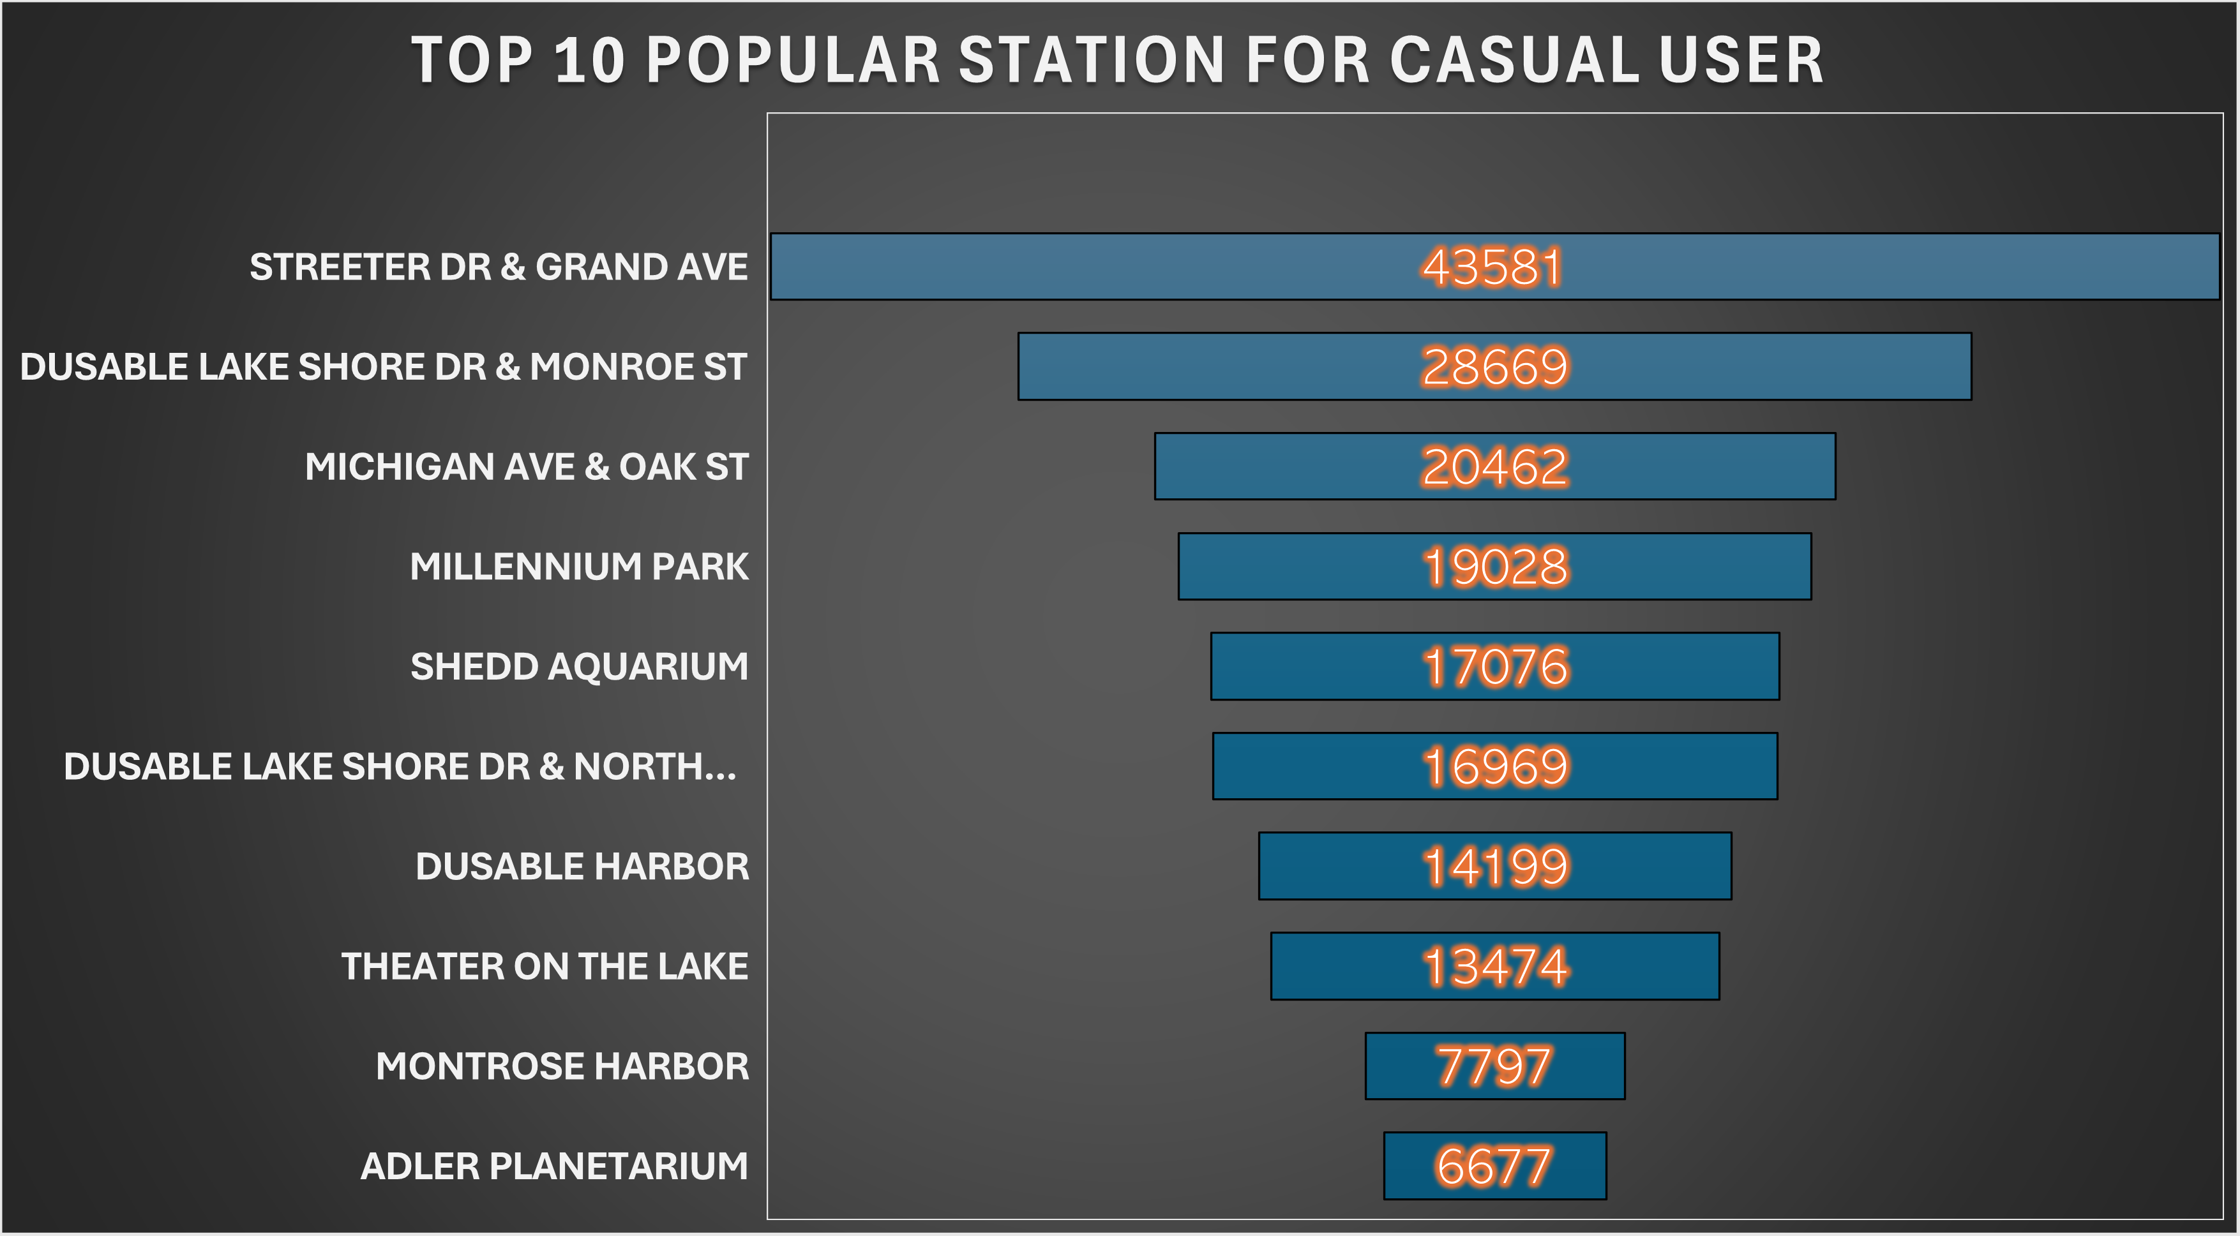
Share:
The popular stations for members are mostly in route to working areas
The popular stations for casual users are mostly parks aquariums and other places that are for recreation.

Slide 17
Act:
Key Takeaways:
Members often use the bike during the weekdays while casual users use the bikes during the weekend
Members often use the bike for work while casual user use them for recreational purposes
Both user prefers classic bikes rather than electric bikes
More people rent bikes in summer and autumn
Casual user have more average ride length than the members

Slide 18
Act:
Recommendations:
Create a membership that categorizes riders into two groups: the business riders(use bikes for work and school) and the leisure riders(use bikes for recreational purposes).
Make sure there are enough bikes on weekends for the leisure riders, especially in parks, aquariums, and other recreational facilities
Make sure there are enough bikes on the weekdays for the business riders.
When making advertisements or marketing for Cyclistic bikes, make sure that the classic bikes are the model for the bikes because both the casual and members like them.
Make sure to up the marketing or make some sort of event in autumn and summer to collaborate with the members and to entice other casual users to subscribe.
Have some sort of discount or specials when a casual user rent a bike for more than the average time

